Slide 1


Northwest Farm Credit Services – Overall Marketing Campaign
Client Need
Based in Spokane, WA, Northwest Farm Credit Services provides financial and insurance services for farmers, ranchers, rural homeowners, and more from Alaska to Montana. Prior to Affirma, Northwest Farm Credit Services had no working marketing plan or direction in how their lead generation or targeting strategy should be ran.
What We Did Affirma hosted a 2-day workshop in Spokane for Northwest Farm Credit Services, outlining Affirma’s agile methodology for constant iteration and inbound marketing for lead generation. Affirma delved deeper into NWFCS’s current marketing plan and revealed and reiterated their goals and objectives, pain points, blockers, and missed opportunities, ultimately using marketing tactics to bolster NWFCS’s marketing campaign.
Results The 2-day marketing workshop led to clear actionable steps and goals for NWFCS to act on in order to maximize their marketing objectives for future growth. Affirma provided a detailed buyer persona, conducted a social media audit, established an email and digital marketing strategy, and finally fully integrate a CRM (Salesforce) and marketing automation platform (Marketing Cloud.)

Slide 2
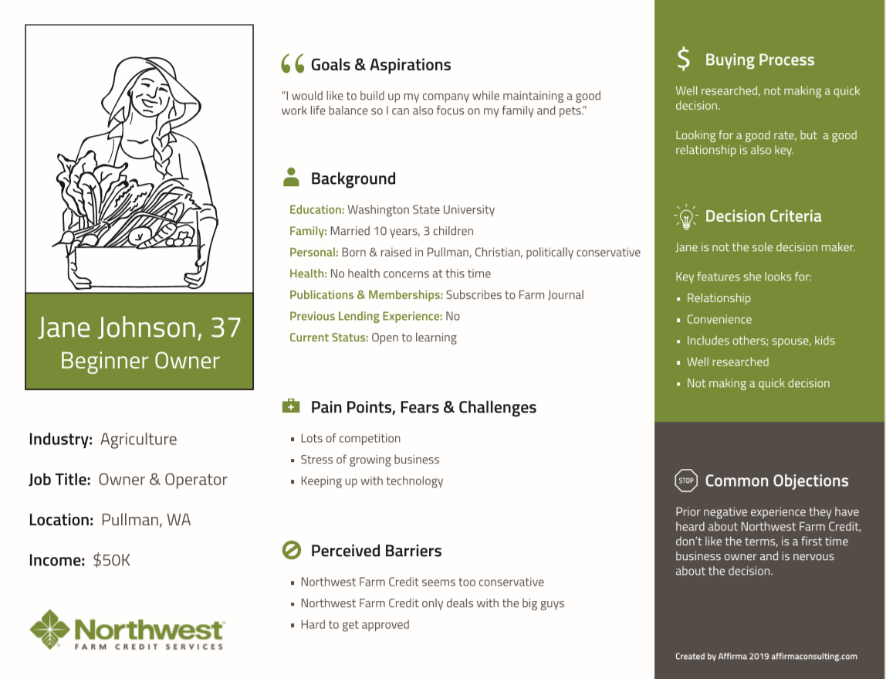
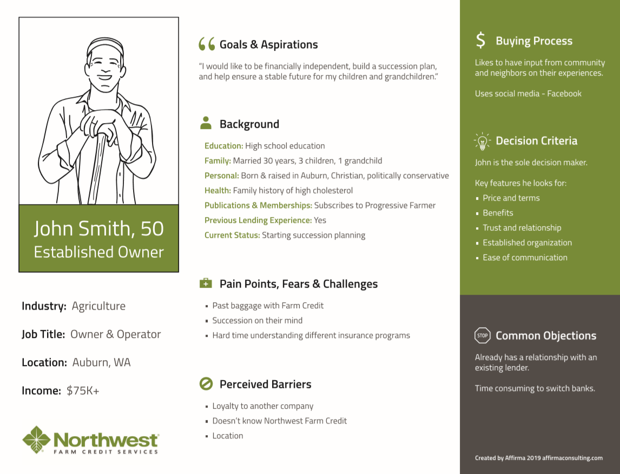
Northwest Farm Credit Services – Marketing Fundamentals
What We Did After the 2-day marketing workshop, one aspect of Affirma’s recommendation was the use of buyer personas, a semi-fictional representation of Northwest Farm Credit Service’s target market created using real data from current consumers. Affirma came up with 2 buyer personas, Jane, the Beginner Owner and John, the Established Owner. These buyer personas create a guide for NWFCS’s targeting strategy, grouping their existing customer base into two segments that NWFCS could better tailor towards each’s personas differing backgrounds, pain points, barriers, and decision criteria.
Results Using these 2 buyer personas, Affirma allowed NWFCS to get a better understanding of their current consumer base and how to cater to two different types of customers. This resulted in a better understanding of how to specially target emails or content for increased engagement, as well as help uncover new opportunities and sources of revenue.

Slide 3
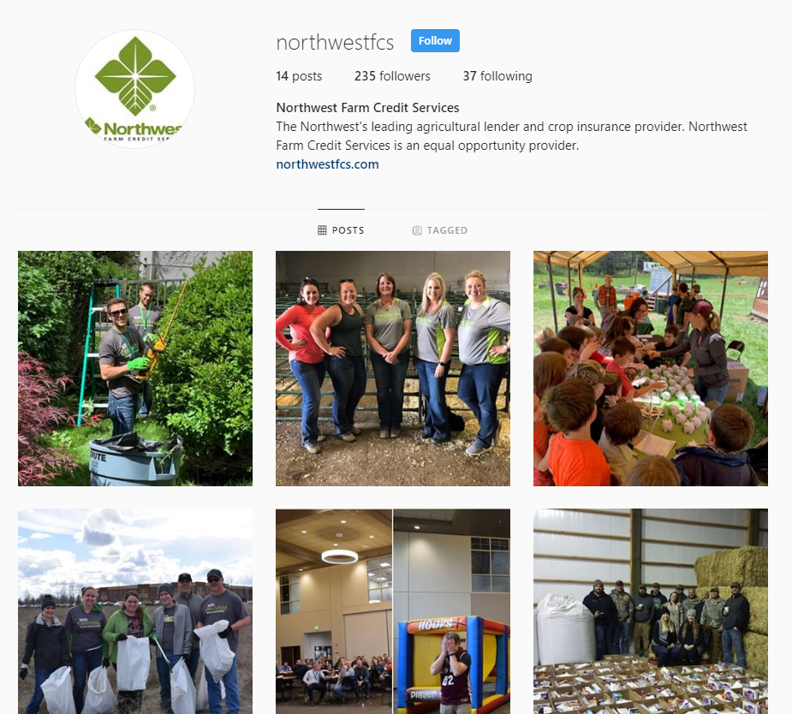
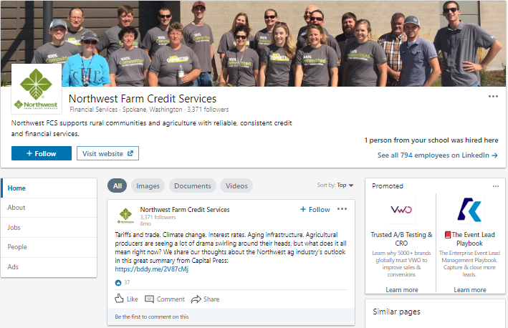
Northwest Farm Credit Services – Social Media Audit
What We Did Affirma performed a social media audit of their LinkedIn, Facebook, Twitter, and Instagram engagement metrics comparing Northwest Farm Credit Services to their top 4 largest competitors (Rabobank N.A., Rabo AgriFinance, Columbia Bank, and Farm Credit Services of America). We looked at page likes, follower count, cadence, and overall content, providing insights on each competitor’s strengths and weaknesses, and how NWFCS fell in the scope of their competitive landscape. Affirma then created a content calendar for future postings.
Results
Following Affirma’s social media audit and insights, NWFCS saw a 14.78% increase in followers on their Instagram, as well as a steady follower increase across their LinkedIn, Facebook, and Twitter. NWFCS has taken Affirma’s social media strategy recommendations and continues to tailor their social media content to encapsulate and bolster their brand awareness.

